Slide 1
Facebook- Online Reputation Management (ORM)
October 2018- april2019
Notes:
‹#›

Slide 2
Agenda
Website | Facebook - ORM
101 account | Sponsored Ads
 | Organic Posts
 | Inbox Messages
‹#›
Notes:
‹#›

Slide 3
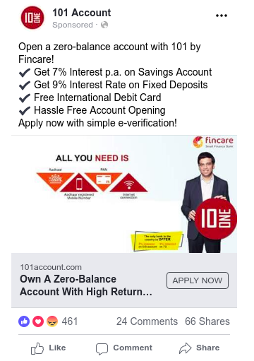
Sponsored Posts
Summary of Sponsored Post
101 Account Page Setup done on 8th Sept,2018
101 Account Campaigns on 11th , 25th and 27th Sep
Avg. Daily spend on FB Ads is Rs15,000
Cost / Click of ₹8.70
Total comments on paid ads as on 11th Oct is 194
S.No. | Date | Comments | No. of Shares | Engagements
Total |  | 194 | 623 | 55245
1 | 27-Oct-18 | 64 | 360 | 27039
2 | 25-Sep-18 | 3 | 2 | 90
3 | 11-Sep-18 | 127 | 261 | 28116
‹#›
Notes:
‹#›

Slide 4
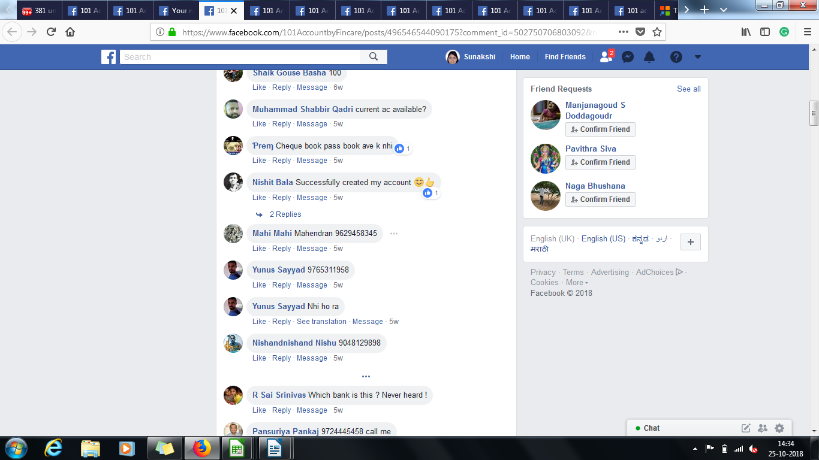
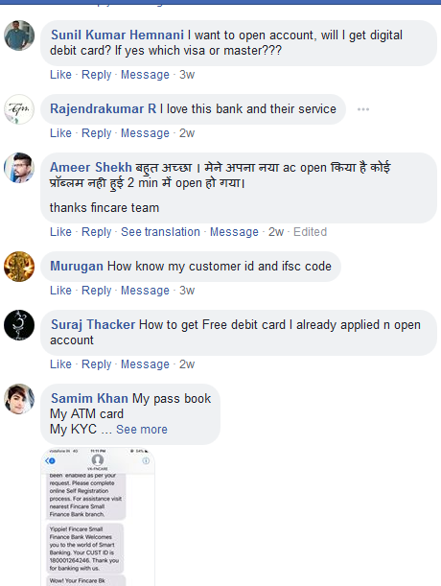
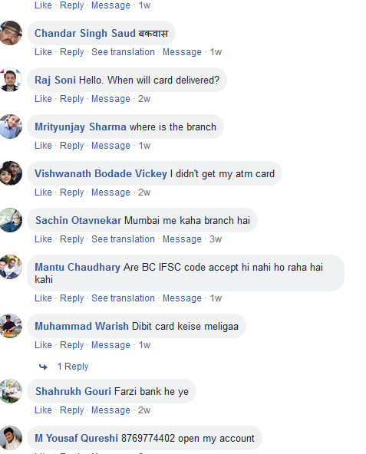
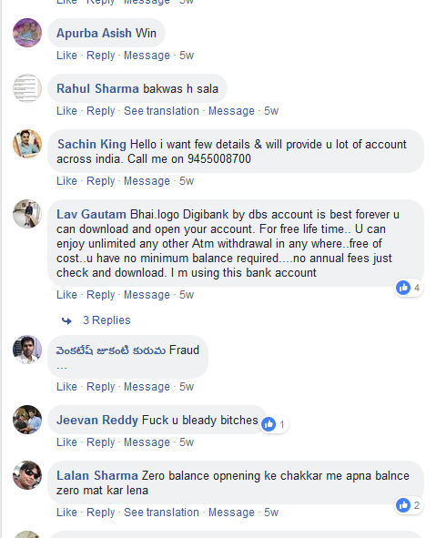
Sponsored Posts- Comment Screenshots
‹#›
Notes:
‹#›

Slide 5
Sponsored Posts
Reputation Management Process
Approaches for the Facebook comments management
Approach1 | Approach 2 | Approach 3 | Approach 4
Page Moderation Block Negative comments- add negative words in Page Moderation | Profanity Filter Block the profanity filter at two levels medium or difficult) Blocks specific words | Instant Revert/Reply for Inbox messages Thank you message to acknowledge customer query | Messenger greetings Greetings to pop-up before user message
List of words to be defined by page owner | List of words specified by Facebook | Auto reverts can be standard or user defined | Greetings can be standard or user defined
Block negative comment to audience, will be visible to page owner | Block negative comment to audience, will be visible to page owner. Reduces Page reach
‹#›
Notes:
‹#›

Slide 6
Sponsored Posts
Comments Categorizations
 | Type1 | Type2 | Type3 | Type4 | Type5 | Type6 | Type7
Comments type | Only phone no is given | Only salutation is given | Fake, Negative and Abusive Comment | 101 Account Opening Process Queries | General Banking queries | Regressive query: Negative Feedback on processes | Applause
Sample Comments | 9877723772 7878675635 | Hello Hi | Fake Fraud | Want to open the account | How to get passbook Customer Id and IFSC | Abusive words Poor customer service | Easy account opening Successful account
Suggestion Sample Revert 1 | Hi {Name}, Please elaborate your concern so that we could assist you further. Also request you to not to any of your bank details in comment section,. Team 101 account | Hi {Name}, Please let us know how can we help you Team 101 Account | Hi {Name}, we certainly understand your concern. Please allow us to sometime to update. Team 101 account | Hi {Name}, glad to know that you want to be the part of Fincare family. Please visit 101account.com for detailed process Team 101 account | Hi {Name}, thank you for showing an interest in our products. We value you and your queries. Please allow us to sometime to update. Team 101 account | Hi {Name}, we have reviewed your queries and you may look forward to receiving a response within 3-4 working days. Team 101 account | Hi {Name}, thank you for the support and trust you have shown in us. For any queries reach us @1800.. Team 101 account
‹#›
Notes:
‹#›

Slide 7
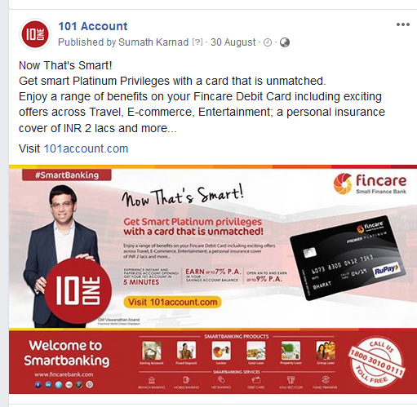
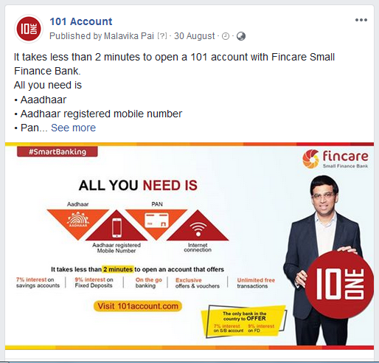
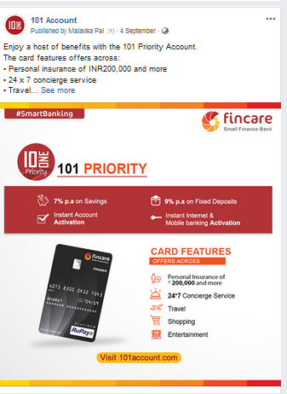
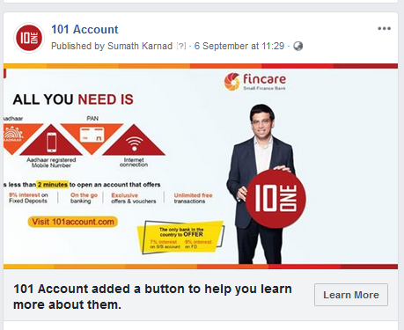
Organic Posts
Summary of Organic Post
S.No. | Date | Reach | Engagement | Clicks | Comments
Total |  | 4322 | 183 | 385 | 15
1 | 04-Oct-18 | 403 | 11 | 26 | 4
2 | 25-Sep-18 | 478 | 18 | 51 | 2
3 | 20-Sep-18 | 469 | 23 | 51 | 1
4 | 19-Sep-18 | 296 | 10 | 35 | 0
5 | 18-Sep-18 | 504 | 25 | 48 | 1
6 | 17-Sep-18 | 391 | 22 | 33 | 1
7 | 12-Sep-18 | 360 | 10 | 30 | 0
8 | 11-Sep-18 | 264 | 14 | 20 | 0
9 | 10-Sep-18 | 719 | 20 | 60 | 1
10 | 07-Sep-18 | 219 | 10 | 5 | 3
11 | 06-Sep-18 | 87 | 3 | 0 | 0
12 | 04-Sep-18 | 83 | 2 | 5 | 0
13 | 02-Sep-18 | 2 | 2 | 0 | 0
14 | 01-Sep-18 | 3 | 2 | 4 | 0
15 | 31-Aug-18 | 5 | 2 | 4 | 0
16 | 31-Aug-18 | 3 | 2 | 4 | 0
17 | 30-Aug-18 | 33 | 5 | 7 | 2
18 | 30-Aug-18 | 3 | 2 | 2 | 0
‹#›
Notes:
‹#›

Slide 8
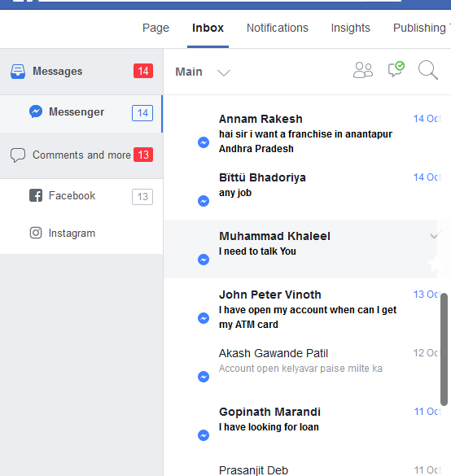
Facebook Inbox Messages
Total messages on 101account page inbox from 11th Sep to 30th Sep is 19
The most common queries are
How to get debit card
Debit card not received
How to apply for loan
Enquiry on branch locations
UPI not available
‹#›
Notes:
‹#›

Slide 9
Common Customer Queries
Facebook comments and messages
Other queries
Current account available.
ATM card still not received.
Email OTP not working.
What is KYC
NO customer care.
No one is answering my query.
How to login to Internet Banking and customer care number
UPI transaction
Credit card option is available
Charges and fees for passbook, debit card
How to find our account ifsc code
101Account related queries
How to open an account.
Account opening online process
How to apply for ATM card.
Minimum balance 25k ????
When will receive an ATM card?
Process of fund transfer?
I tried the first step but no reply
Next Steps- to be answered
FPR to handle all comments and queries?
How to tag customer complaints to product team
TAT to revert all queries
Should we hide negative Comments/feedback/customer service issues
‹#›
Notes:
‹#›

Slide 10
THANK YOU
‹#›

